Slide 1


BE MEDIA SMART
STOP I THINK I CHECK

Slide 2


BE MEDIA SMART

Slide 3

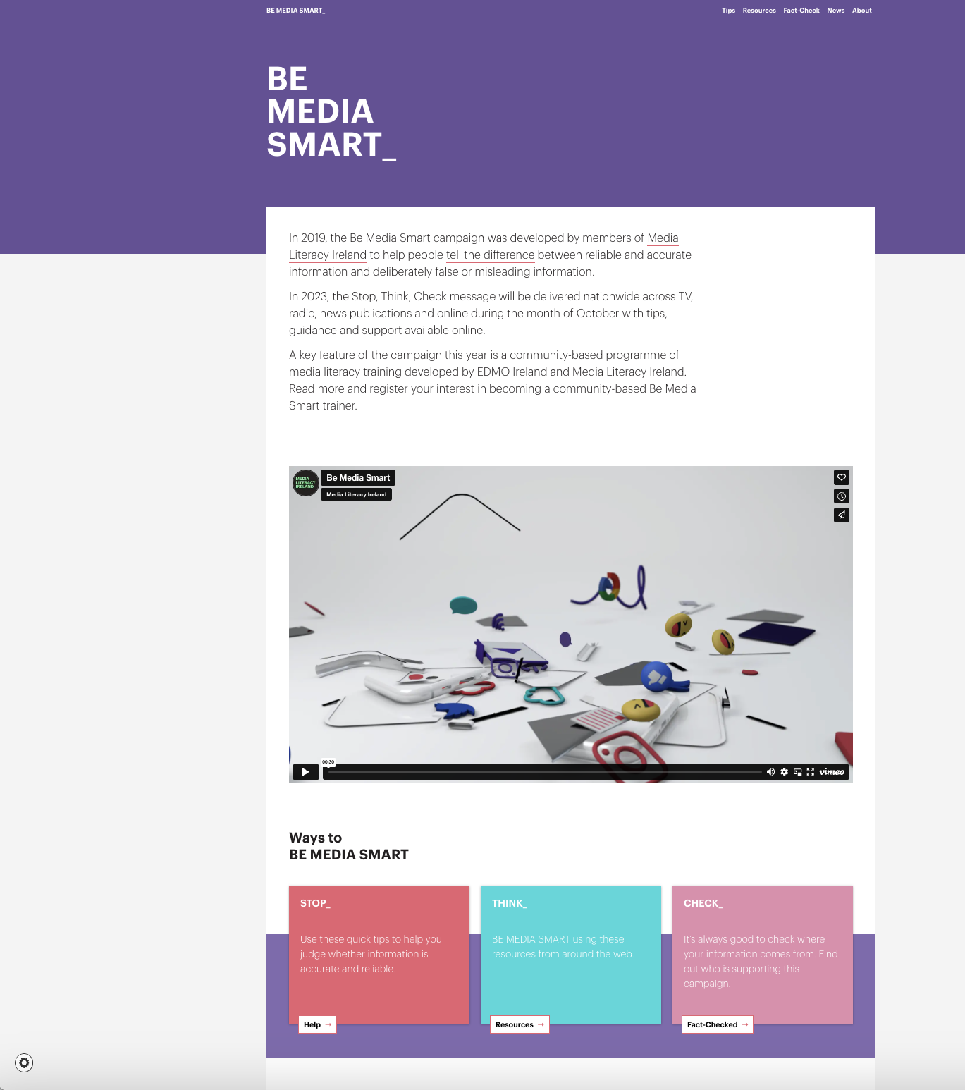
BeMediaSmart.ie

Slide 4
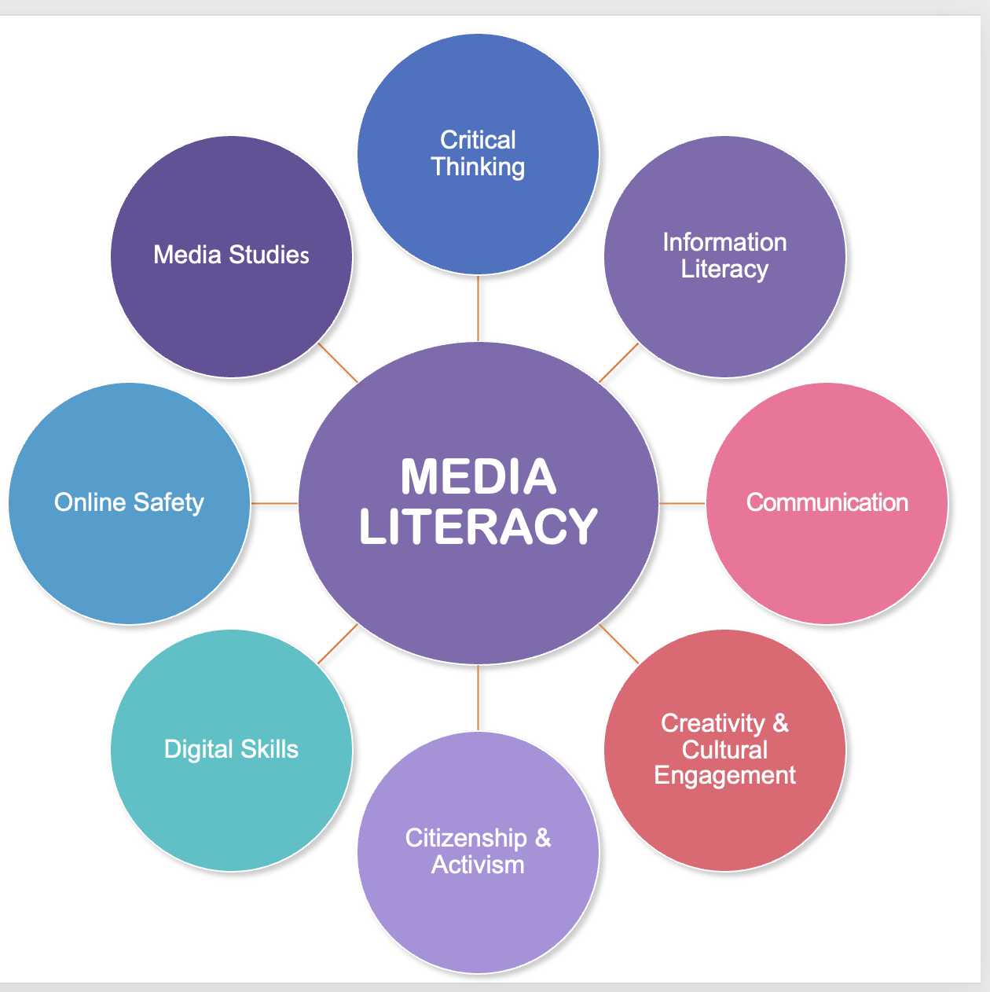
MEDIA LITERACY
Critical Thinking
Information Literacy
Communication
Creativity & Cultural Engagement
Citizenship & Activism
Digital Skills
Online Safety
Media Studies
MEDIA LITERACY

Slide 5

CRITICAL APPROACH: MEDIA CONTENT & INFORMATION
Empowering citizens to make well-informed decisions about the content & information.
Equip people with the knowledge & skills
to critically evaluate the information
Learn to identify trustworthy sources
Analyse media messages
Use information in a responsible way

Slide 6

LEARNING INTENTIONS
IN THIS WORKSHOP YOU WILL:
DISCUSS & EXPLAIN
Many challenges imposed by the information age, especially in relation to the analysis, evaluation and use of information;
EXPLORE
How media messages are constructed and represent the world around us;
DISCUSS
The causes and consequences of disinformation and other forms of information manipulation;
ANALYSE
The main affordances and characteristics of digital media platforms and understand how they affect your experience online.
DEVELOP
Skills to communicate about the critical approach to media literacy
BUILD
Strategies to evaluate media content and have a healthy information diet

Slide 7

YOUR PARTICIPATION
DISCUSSIONS & ACTIVITIES
VERY IMPORTANT
SENSITIVE TOPICS MAY EMERGE
Let’s practice KINDNESS & RESPECT
We are all here to learn (including myself)!
Do not worry about being wrong or saying something inaccurate!

Slide 8
ICE BREAKER

Slide 9
DISCUSS IN GROUPS
Examples where you were unsure whether something was TRUE or FALSE or REAL or FAKE
What was the mode of communication? (text, image, video...)
What was the format? (eg. news article, ad, meme,.)
Reasons you were unsure about the veracity of information
What was the topic?

Slide 10


WE ARE ALL potentially
DIGITAL MEDIA CREATORS
INTERNET
DIGITAL MEDIA
IDEA
DIGITAL MEDIA CONTENT
=

Slide 11

THE INFORMATION AGE
Constantly bombarded with information coming from many different sources…

Slide 12






THE INFORMATION AGE
TEXT
… and in DIFFERENT FORMATS!
VIDEO
IMAGE
AUDIO
TO ‘READ’ ALL THESE FORMATS?
INFO GRAPHICS
GIFS

Slide 13

THE INFORMATION AGE
NEWS
ADVERTISING
ENTERTAINMENT
MEMES
INFO & EDUCATIONAL
SCIENTIFIC

Slide 14
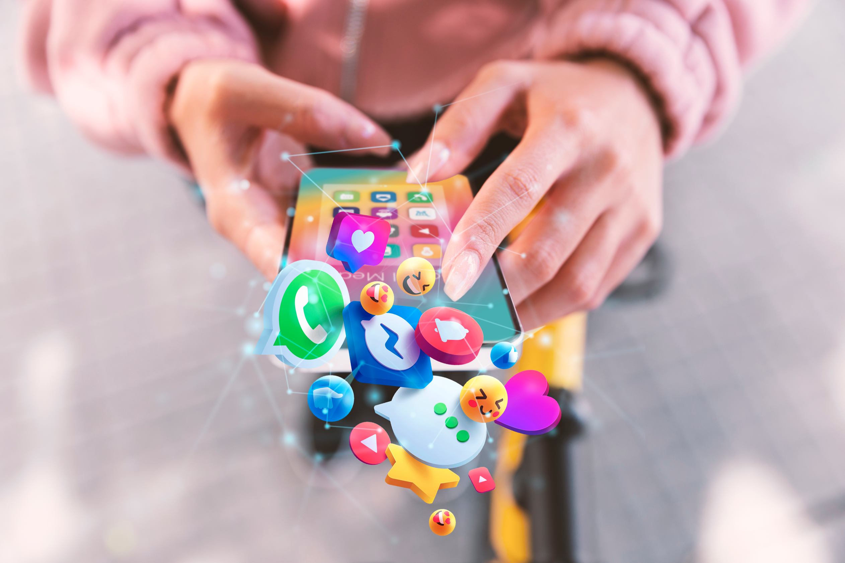
THE INFORMATION AGE
Amidst this ocean of information, DIGITAL PLATFORMS and MEDIA ORGANIZATIONS compete
In order to

Slide 15

Source: Tactical Tech - https://theglassroom.org/en/misinformation-edition

Slide 16

THE INFORMATION AGE
KEEP YOU
PLATFORMS designed to grab attention & keep users engaged.
Combination:
UX strategies
Psychological principles
Data-driven techniques (Algorithms push content).
Designed to ATTRACT interest, DRIVE viewership or readership, & ultimately GENERATE REVENUE => advertising & subscriptions.

Slide 17

THE INFORMATION AGE
MEDIA ORGANIZATIONS & CONTENT CREATORS: Various strategies and techniques to PERSUADE users to CLICK on their LINKS!
EYE-CATCHING HEADLINES: evoke curiosity
SENSATIONALIST LANGUAGE: shocking & people want to learn more by clicking on the link.
THE GOAL: Grab attention, spark interest & ultimately drive users to engage with content.

Slide 18

THE INFORMATION AGE
STOP

Slide 19

STOP
STOP in this context means that we must be attentive, focused and cautious when we encounter media content

Slide 20

ACTIVITY 1
STOP

Slide 21
Think about strategies to MEANINGFULLY STOP when you encounter information or media content.
Think about your everyday experience with digital media. What typically draws your attention? What distracts you the most?
Do you usually know the source of the information before engaging with it? What makes a good source of information?
About your personal bias: Do you know what it is and, if so, do you think it affects the way you interpret/understand the content?

Slide 22

STOP
THE MEDIA ENVIRONMENT: its features & how it influences the way we engage with information.
THE SOURCE OF INFORMATION: If we don’t know who created a piece of content, we cannot even start the process of assessing its reliability.
PERSONAL BIAS: Ask yourself: how my personal preferences may influence the way I understand the content? We cannot get rid of confirmation bias, but being aware of it helps a lot.

Slide 23



Slide 24
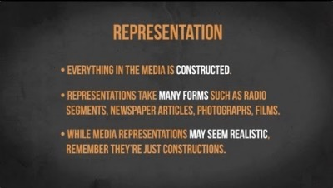
MEDIA CONTENT

Slide 25

MEDIA CONTENT
HOW various ideas, concepts, experiences, groups, individuals, identities, and cultures are DEPICTED, PORTRAYED, or SHOWN in DIFFERENT MEDIA FORMS: TV, film, news, advertising & online content.
REPRESENTATION: Plays a significant role in shaping how we see the world around us.

Slide 26

MEDIA CONTENT
There are many different ways of telling the same story…

Slide 27






MEDIA CONTENT
THE ROLE OF
Vital role: for experiencing media content in the digital age.
INFLUENCE:
What type of content we see,
When we see it,
How we engage with it.
SHAPE users experience of digital platforms
(eg. social media, search engines, streaming, news sites)

Slide 28

MEDIA CONTENT
THINK

Slide 29
To understand to begin our process of engaging with media content: REPRESENTATION, EDITING & ALGORITHMIC MANIPULATION

Slide 30
ACTIVITY 2
THINK

Slide 31
BRAINSTORM
What are the many ways in which media content can be manipulated to mislead or deceive us?

Slide 32
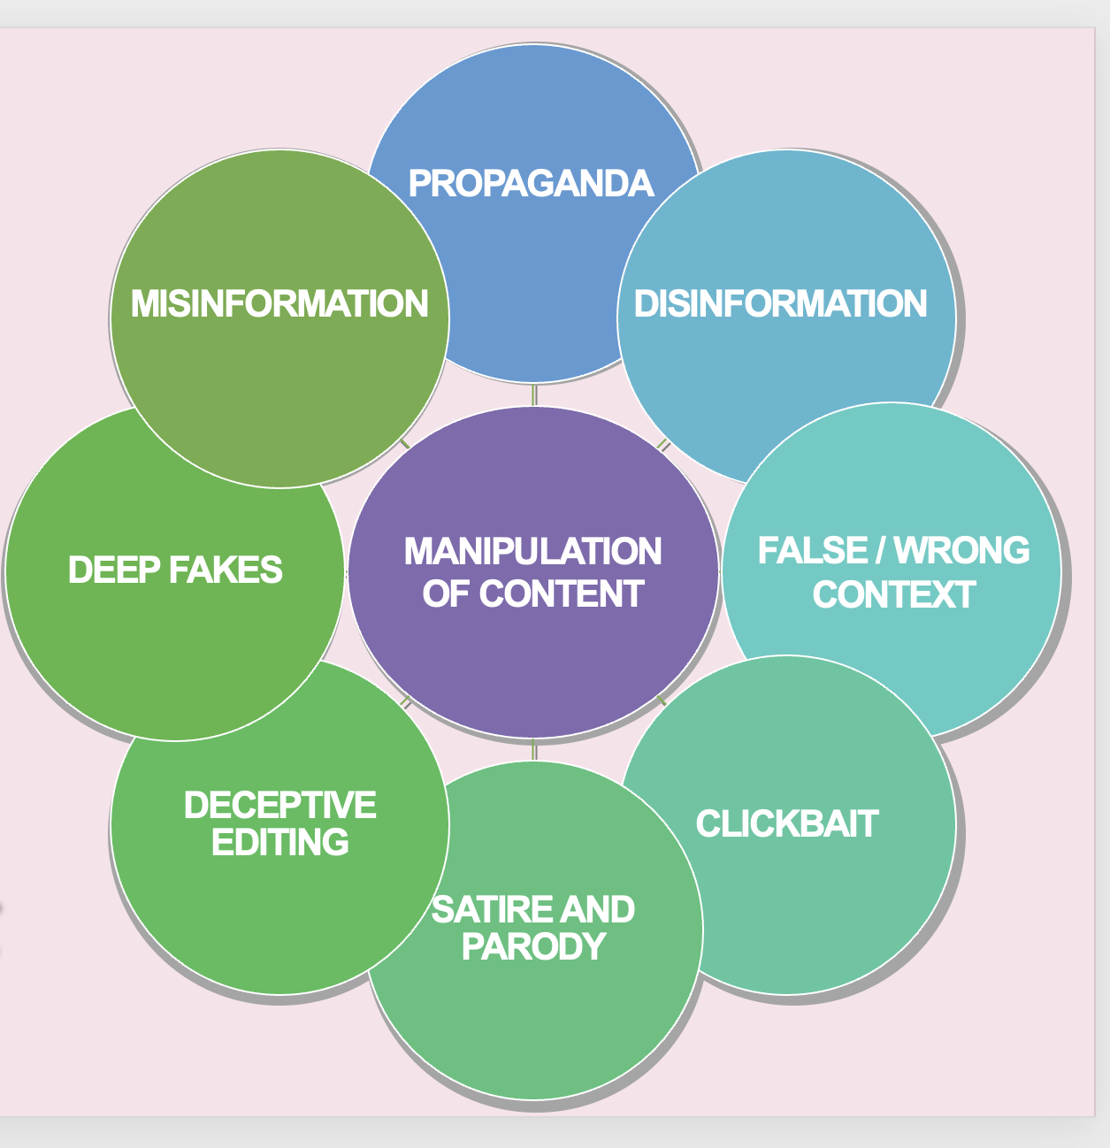
MANIPULATION OF CONTENT
FALSE/WRONG CONTEXT
CLICKBAIT
SATIRE AND PARODY
DECEPTIVE EDITING
DEEP FAKES
MANIPULATION OF CONTENT
CLICKBAIT
SATIRE AND PARODY
DECEPTIVE EDITING
DEEP FAKES
PROPAGANDA
MISINFORMATION
DISINFORMATION
FALSE / WRONG
CONTEXT
What does each category mean?
What are possible consequences of this kind of manipulation?

Slide 33
ACTIVITY 3
CHECK

Slide 34

ACTIVITY 3: CHECK
STRATEGIES & BEST PRACTICES to CHECK if a piece of information or media content is ACCURATE or NOT.
This includes content in any format (text, image, video...)

Slide 35


ACTIVITY 3: CHECK
Lateral reading
News source evaluation
Images & videos verification

Slide 36
ACTIVITY 3: CHECK
1. What is possible to do with the technology we have and the time available
Must do all the time
Do in some situations
Never do
2. The importance and the potential impact of the piece of information being analysed
Not important
Somewhat important
Extremely important

Slide 38
STOP
To PREPARE yourself BEFORE you meaningfully engage with media content.
Need to make sure we have full attention & focus when dealing with content.
It is like running checks in our mind to make sure we are aware of the following:

Slide 39
STOP
THE MEDIA ENVIRONMENT: its features & how it influences the way we engage with information.
THE SOURCE OF INFORMATION: If we don’t know who created a piece of content, we cannot even start the process of assessing its reliability.
PERSONAL BIAS: Ask yourself: how my personal preferences may influence the way I understand the content? We cannot get rid of confirmation bias, but being aware of it helps a lot.

Slide 40
THINK
MANIPULATION OF CONTENT
FALSE/WRONG CONTEXT
CLICKBAIT
SATIRE AND PARODY
DECEPTIVE EDITING
DEEP FAKES
MANIPULATION OF CONTENT
CLICKBAIT
SATIRE AND PARODY
DECEPTIVE EDITING
DEEP FAKES
PROPAGANDA
MISINFORMATION
DISINFORMATION
FALSE / WRONG
CONTEXT
To understand to begin our process of engaging with media content: REPRESENTATION, EDITING & ALGORITHMIC MANIPULATION
Once we fully understand these basic concepts, we can think about the different categories of content manipulation. This makes us more cautious, alert and, consequently, more resilient to manipulative media content.

Slide 41

THINK
Once we fully understand these basic concepts,
we can think about the different categories of content manipulation.
This makes us MORE CAUTIOUS, ALERT and, consequently, MORE RESILIENT to manipulative media content.

Slide 42

CHECK
To take once to assess the ACCURACY & RELIABILITY of media content:
Check the reliability & reputation of the SOURCE;
Check the author's QUALIFICATIONS & EXPERTISE on the topic;
Check if OTHER SOURCES are reporting the story (cross-reference);
Check if reputable fact-checking WEBSITES have assessed the story;
Check for SIGNS of DECEPTIVE editing, especially with images & videos;
Check the QUALITY of the text & presentation: be aware of poorly written messages, sensational or exaggerated headlines; and overly emotive content.

Slide 43
MEDIA LITERACY FOR CITIZENSHIP
MEDIA LITERACY FOR CITIZENSHIP:
Individuals should be empowered to critically engage with media content, navigate the information landscape, and actively participate in the society as responsible and well-informed citizens.
DISINFORMATION and other forms of content manipulation are a real threat to democratic societies.
As citizens, we must look after our information diet and make sure we access, use and share information in a responsible manner.
Actively participating in civic life and contributing to the well-being of society.
It encompasses responsibilities such as staying informed about current events to meaningfully engage in public debates, participating in democratic processes, such as elections, and advocating for positive change.

Slide 44
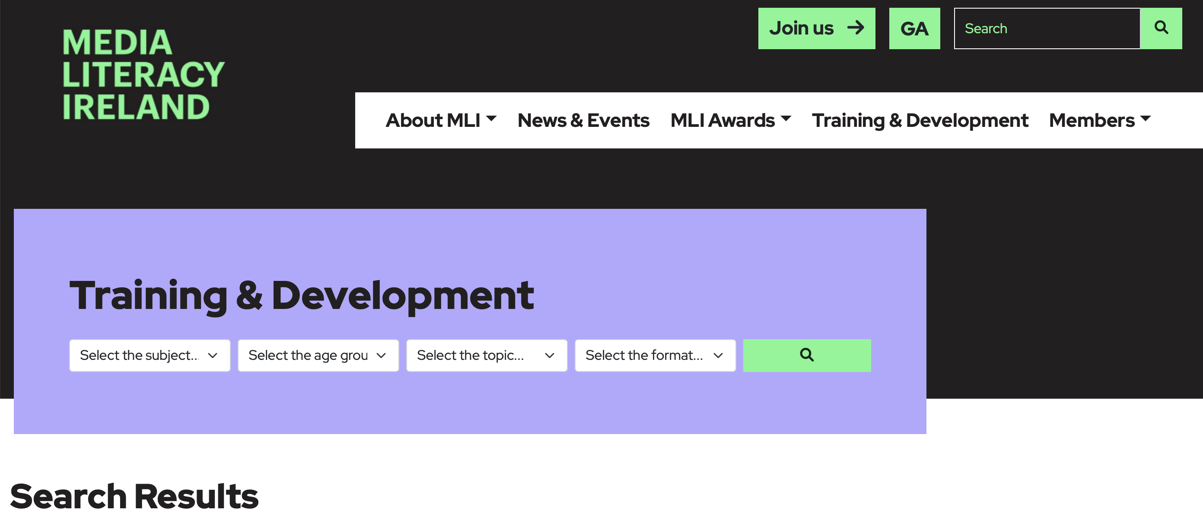
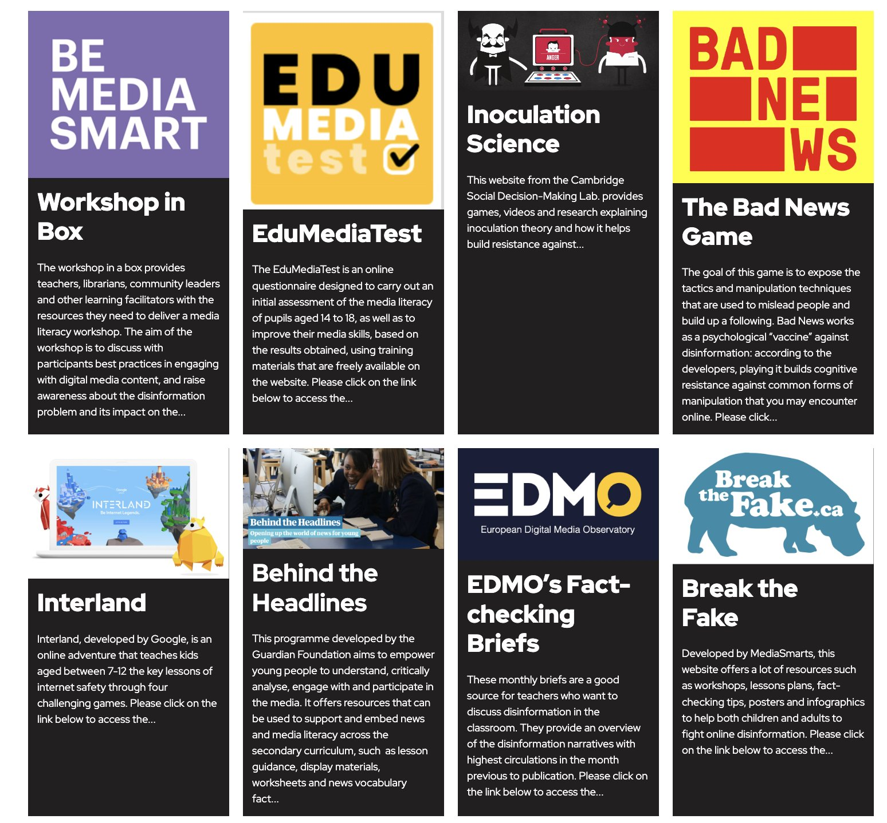
RESOURCES
www.medialiteracyireland.ie/training-development/

Slide 45

Questions?

Slide 46
BE MEDIA SMART
ACKNOWLEDGEMENTS
BE MEDIA SMART is an initiative of Media Literacy Ireland. Facitilated by Coimisiún na Meán, MLI is an independent, informal, alliance of people and organisations working together to promote media literacy in Ireland.
The BE MEDIA SMART Training Programme was developed by Dr. Ricardo Castellini da Silva on behalf of EDMO Ireland.
STOP I THINK I CHECK
www.bemediasmart.ie
Media Literacy Ireland
W: medialiteracyireland.ie
E: info@medialiteracyireland.ie
EDMO Ireland
W: edmohub.ie
E: info@cnam.ie

